Slide 1
IPC VIA SHARED FILES
Presented by Aurshia Mudassar

Slide 2
What is a Process?
A program in execution
Has its own memory, variables, CPU time
Processes cannot access each other’s memory directly

Slide 3
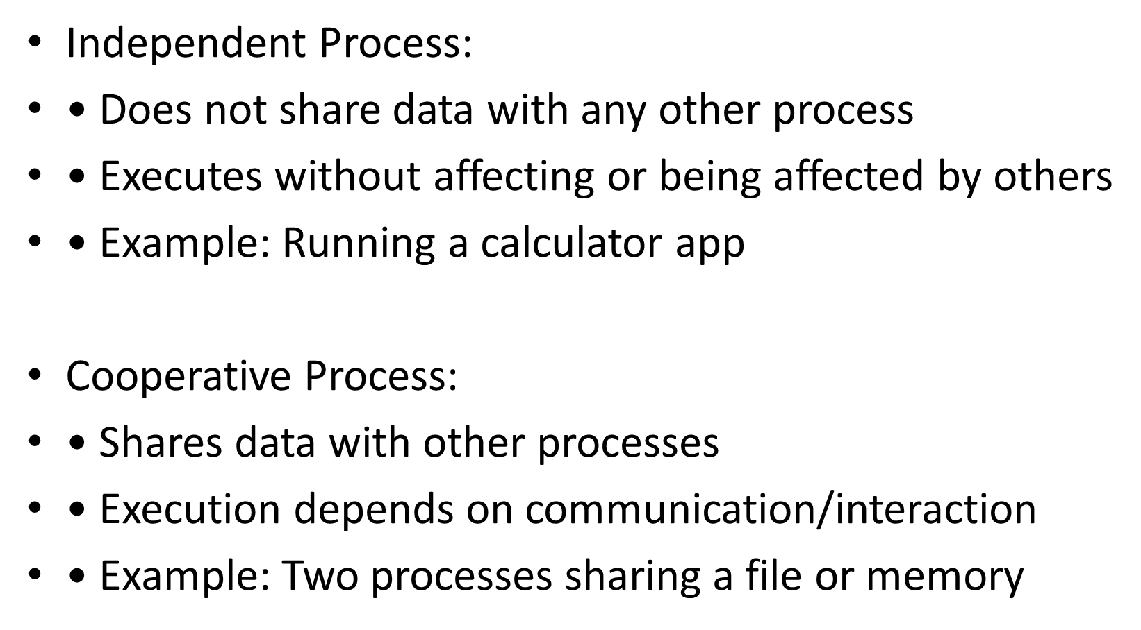
TYPES

Slide 4
What is IPC?
Mechanisms that allow processes to:
Share data
Coordinate tasks
Send messages
Work together

Slide 5
Why IPC is Needed
• Data sharing
• Synchronization (processes run in the correct order)
• Better system design (Dividing a large system into small independent components (modular design)

Slide 6
Types of IPC
• Pipes
• Message Queues
• Shared Memory
• Sockets
• Signals
• Shared Files (focus)

Slide 7
What is IPC via Shared Files?
Processes communicate by reading/writing the same file.
A file acts as communication medium.

Slide 8
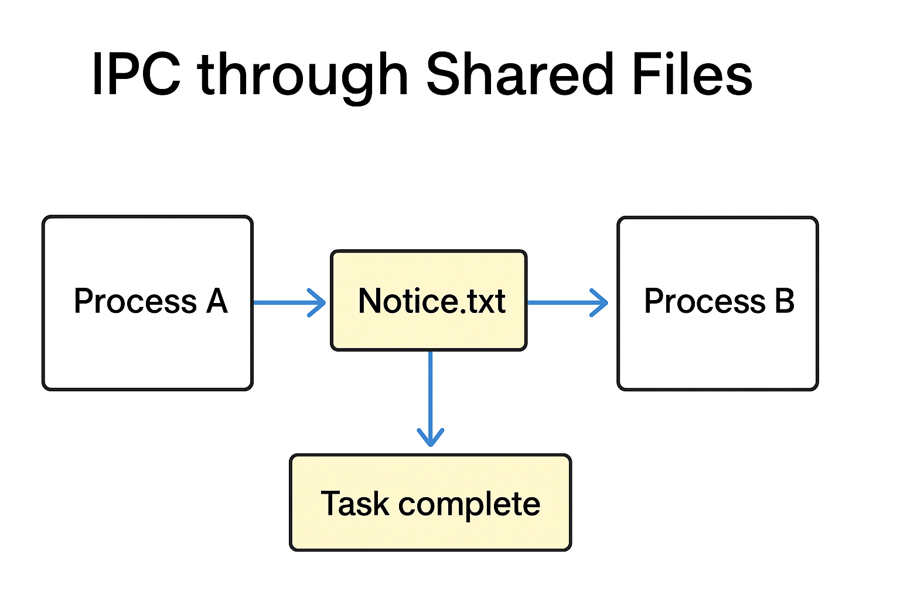
Diagram
Process A (writer) → shared.txt → Process B (reader)

Slide 9
How It Works
Create shared file
Writer writes data
Reader reads data
Locking prevents corruption
Polling checks changes

Slide 10
Writer Example
#include <fcntl.h> // open()
#include <unistd.h> // write(), close()
#include <string.h> // strlen()
int main() {
int fd = open("shared.txt", O_WRONLY | O_CREAT | O_TRUNC, 0644);
const char *msg = "Hello from Process A!";
write(fd, msg, strlen(msg));
close(fd);
return 0;
}

Slide 11
Reader Example
#include <fcntl.h> // open()
#include <unistd.h> // read(), close()
#include <iostream>
using namespace std;
int main() {
int fd = open("shared.txt", O_RDONLY);
char buffer[100];
int n = read(fd, buffer, sizeof(buffer) - 1);
buffer[n] = '\0'; // end the string
cout << buffer << endl;
close(fd);
return 0;
}

Slide 12
Advantages
• Simple
• Permanent storage (data persists even after the process ends)
• Large data support (it handles large amount of data)

Slide 13

Disadvantages
Slow (Disk involving reading / writing is much slower than RAM)
Not real-time (not fast)
Needs locking
Risk of corruption (some crash occurs)
(12345)------→(12)
crash

Slide 14
Real-Life Examples
Canteen Menu:
process A : Canteen Staff
Process B : Student
they communicate through 1 shared file menu.txt
canteen staff write in the menu.txt while the students read the menu.txt

Slide 15
Summary
IPC via shared files = simple but slow communication using disk files.

